Slide 1
Application of Cooling Rates in Steel Making Processes
Simran Sarkar 2301MM24
Jyoti Shikha 2301MM08

Slide 2
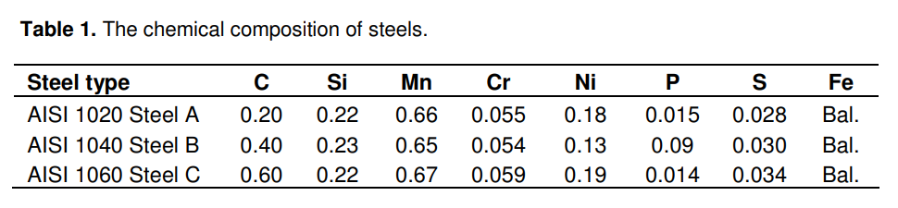
Effect of Cooling Rate on Hardness and Microstructure of AISI 1020, AISI 1040, and AISI 1060 Steels [3]
AlSI | Steel Type | Pearlite Content
1020 | Low C Content | 25 %
1040 | Medium C Content | 50 %
1060 | High C Content | 75 %

Slide 3

Annealing at 900K to remove residual stresses
Heated to 1250K for 4 hours to achieve uniform austenite phase.
2 x 2 x 20 mm³
Steel Plate
Water quenching
(fastest cooling)
Air cooling
(moderate cooling)
Furnace cooling
(slow cooling)
Hardness Testing: Vickers microhardness test with 100g load.
Microstructure Observation: Optical microscope

Slide 4
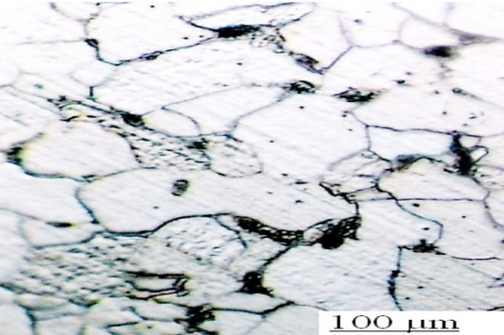
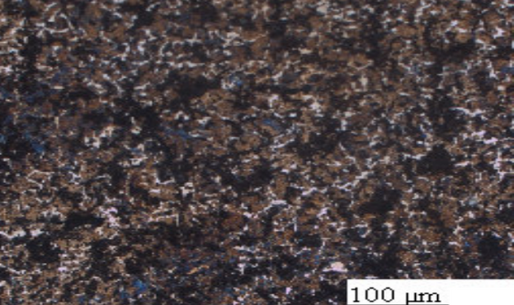
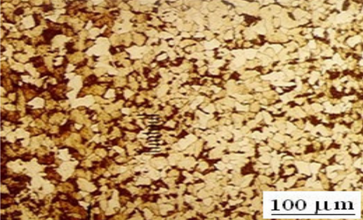
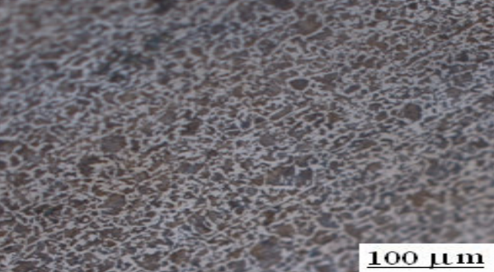
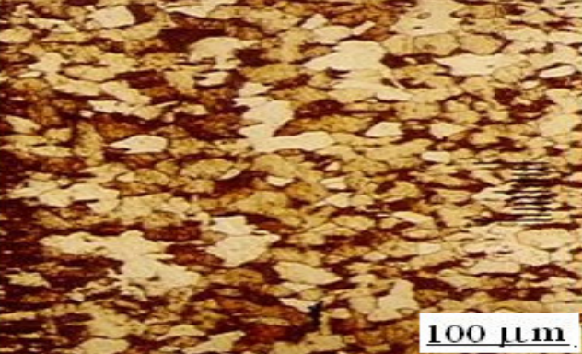
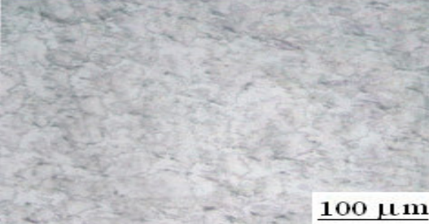
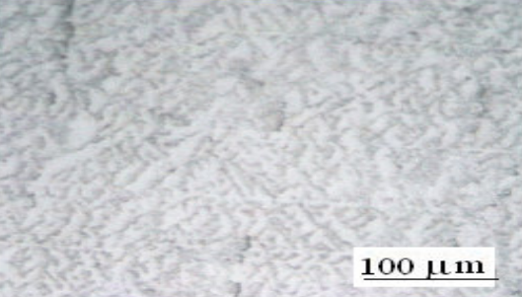
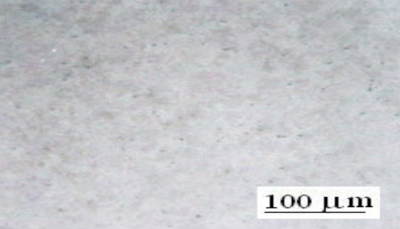
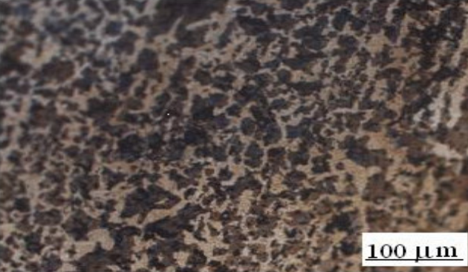
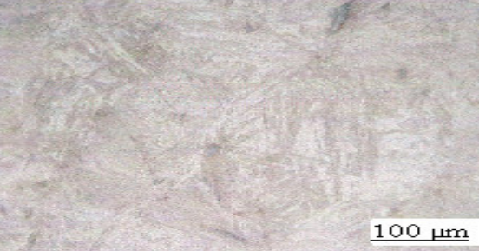
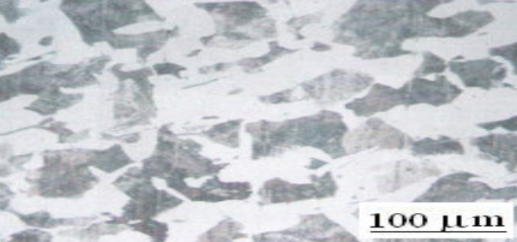
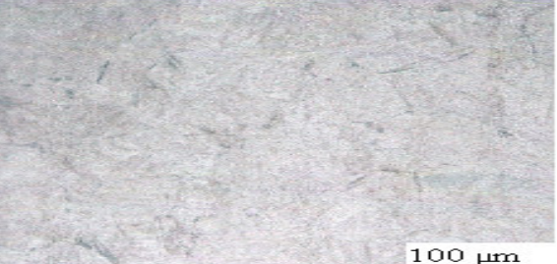
 | Steel Type | Water Quenched (fastest Cooling ) | Air Cooled ( Moderate Cooling ) | Furnace Cooling ( Slow Cooling )
AISI 1020
AISI 1040
AISI 1060

Slide 5
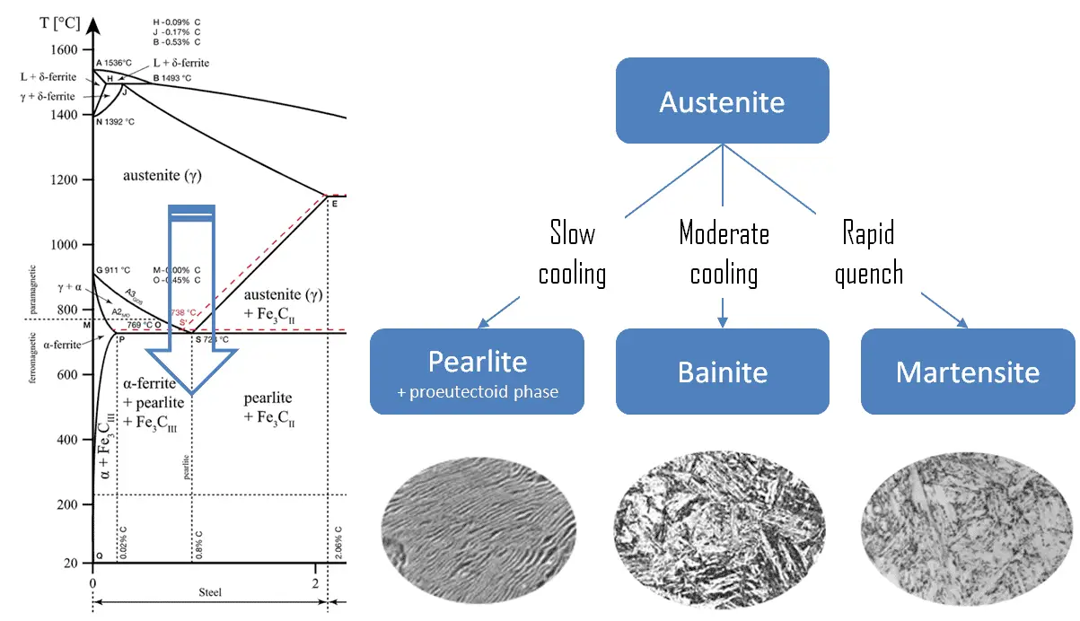
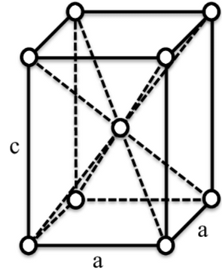
If austenite is cooled very rapidly (quenched), it transforms into martensite, a Body-Centered Tetragonal (BCT) structure.
Martensite is extremely hard and brittle, requiring further heat treatment (tempering) to improve toughness.
Used in cutting tools, hardened steel, and wear-resistant applications.
Austenite cools slowly, it transforms into pearlite (a layered structure of ferrite and cementite).
This structure is strong and wear-resistant.
Found in rails, wires.
[7]
If austenite cools at a moderate rate, it transforms into bainite, a mixture of ferrite and cementite in a more refined form.
Bainite has higher strength and toughness than pearlite, making it useful in automotive parts and structural applications.
[8]

Slide 6
Microstructure | Microstructure Details | Properties | Applications
Austenite | Face-centered cubic (FCC) structure, more closely packed | High toughness, good ductility, corrosion resistance, high temp stability | Stainless steels, high-temperature components
Pearlite | Alternating layers of ferrite and cementite, lamellar structure | Better Fatigue Resistance Along Grain Direction, Lower Resistance to Cracking | Railway tracks, wires, springs
Bainite | Fine mixture of ferrite and cementite, formed at intermediate cooling rates | Good strength & toughness, better fatigue resistance than pearlite | Automotive components, structural applications, gears
Martensite | Body-centered tetragonal (BCT) structure, needle-like grains, formed by rapid quenching | Very hard & brittle, high wear resistance | Cutting tools, wear-resistant surfaces, hardened steels

Slide 7
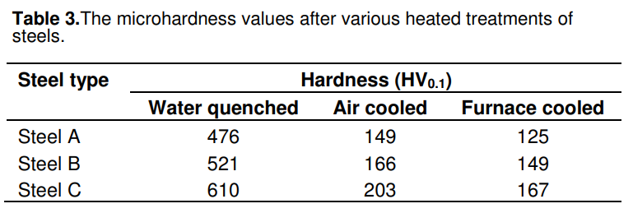
higher C content of steel => higher hardness
higher cooling rate => higher hardness

Slide 8
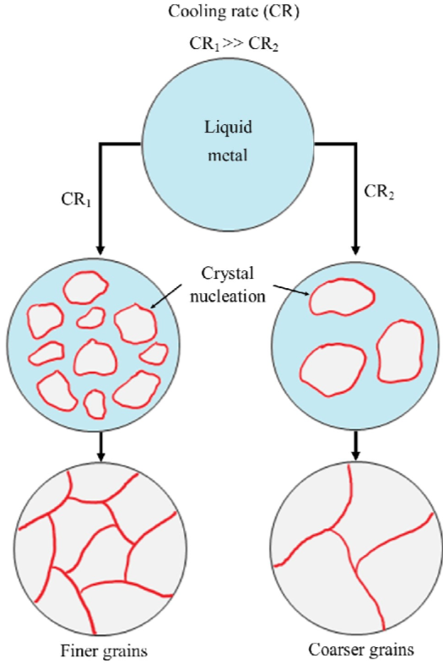
The cooling rate in steelmaking is critical because it directly influences the microstructure and mechanical properties of the steel.
• A slow cooling rate allows the formation of equilibrium phases like pearlite or ferrite, resulting in softer and more ductile steel
• Rapid cooling (quenching) can suppress diffusion, leading to the formation of hard and brittle martensite.
• Faster cooling producing finer grains that enhance strength and toughness
• Slower cooling promotes grain growth, reducing strength but improving ductility.
• Rapid cooling can introduce residual stresses, increasing the risk of cracking
• Controlled cooling methods like annealing or normalizing help refine the microstructure and relieve stresses.
The choice of cooling rate is crucial in balancing hardness, toughness, and machinability, ensuring steel meets specific performance requirements for various applications.
Schematic diagram showing effect of cooling rate on grain size.
[1]

Slide 9
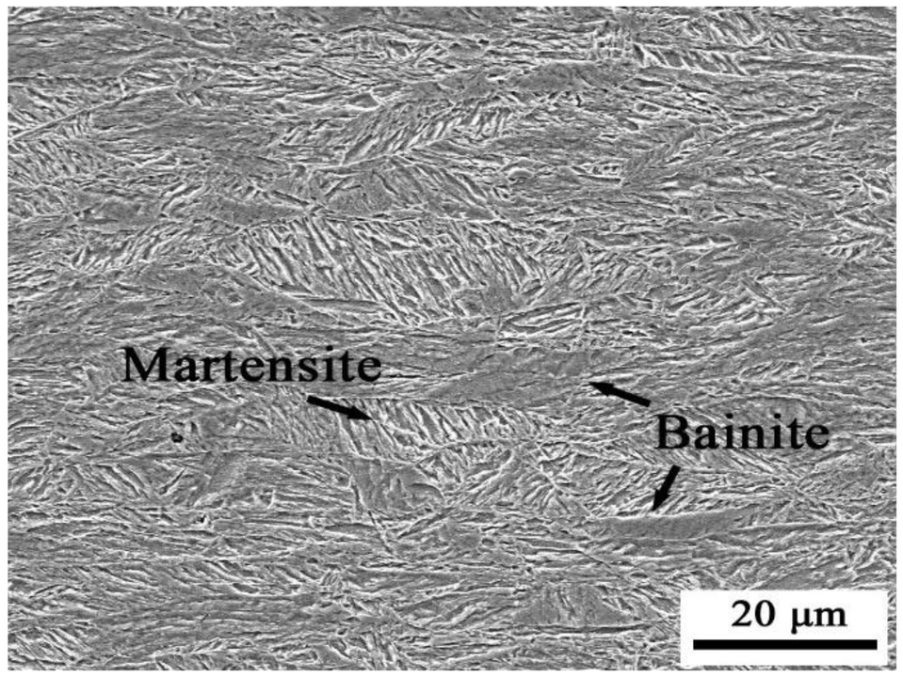
Case Study 1
Mixed Microstructure: The presence of martensite increases hardness and strength but reduces toughness.
The presence of both martensite and bainite suggests that the steel underwent an intermediate cooling rate—not too rapid (which would fully form martensite) and not too slow (which would lead to pearlite or ferrite).
Bainite provides toughness while retaining good strength, making this dual-phase microstructure beneficial for wear resistance and impact strength.
This kind of structure is often seen in tempered or bainitic steels, which are used in applications like automotive components, rails, and high-strength structural materials.
[2]

Slide 10
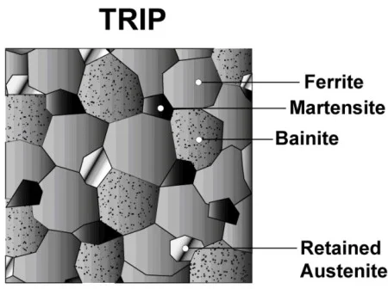
Case Study 2
TRIP Steel (Transformation-Induced Plasticity): A type of advanced high-strength steel (AHSS) known for its excellent combination of strength and ductility.
Microstructure Components:
Ferrite: Provides ductility and toughness.
Martensite: Enhances strength but reduces ductility.
Bainite: Offers a balance of strength and ductility.
Retained Austenite: Transforms into martensite under stress, contributing to the TRIP effect.
Key Feature: The retained austenite transforms into martensite under mechanical stress, increasing strength and toughness dynamically.
Applications: Widely used in the automotive industry for crash-resistant structures.
[5]

Slide 11
Conclusions
In steelmaking, the cooling rate plays a vital role in determining the final microstructure and mechanical properties of the steel. A carefully controlled cooling process allows for a balance between hardness, toughness, and machinability, ensuring the steel meets desired performance standards. While rapid cooling enhances strength through finer grains and martensitic transformation, it may also introduce brittleness and residual stresses. Conversely, slower cooling improves ductility but can reduce strength due to grain growth. By employing controlled cooling techniques such as annealing or normalizing, manufacturers can optimize steel properties for diverse industrial applications.
[2]

Slide 12
References
[1]The Role of Metallurgical Features in the Microbially Influenced Corrosion of Carbon Steel: A Critical Review - Scientific Figure on ResearchGate. Available from: https://www.researchgate.net/figure/Schematic-diagram-showing-effect-of-cooling-rate-on-grain-size_fig1_380308241 [accessed 25 Mar 2025]
[2]Li, D.; Wu, K.; Dong, H.; Isayev, O.; Hress, O. Coarse Grained Heat-Affected Zone Microstructure and Brittleness of Ti-Nb-B Microalloyed High Toughness and Wear Resistant Steel. Metals 2019, 9, 289. https://doi.org/10.3390/met9030289
[3]Çalik, Adnan. "Effect of cooling rate on hardness and microstructure of AISI 1020, AISI 1040 and AISI 1060 Steels." International journal of Physical sciences 4.9 (2009): 514-518.

Slide 13
[4]Investigation of microstructure and mechanical properties of austenitic steel bimetallic structures fabricated using wire arc direct energy deposition for remanufacturing applications. Available from: https://www.sciencedirect.com/science/article/pii/S2666330925000081
[5]https://www.azom.com/article.aspx?ArticleID=11244
[6]https://www.researchgate.net/publication/329162863_Investigation_on_the_microstructure-mechanical_property_correlation_in_dissimilar_steel_welds _of_stainless_steel_SS_304_and_medium_carbon_steel_EN_8
[7]https://www.nuclear-power.com/nuclear-engineering/materials-science/phase-diagrams-of-iron-carbon-system/common-phases-in-steels/
[8]https://www.researchgate.net/figure/The-body-centered-tetragonal-structure_fig2_237488184

Slide 14
THANK YOU

